Slide 1
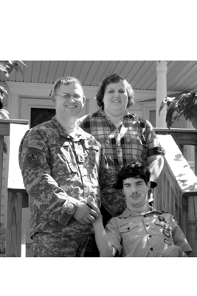
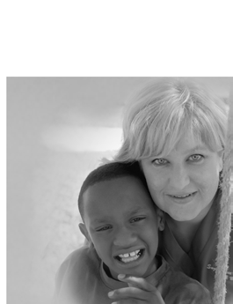
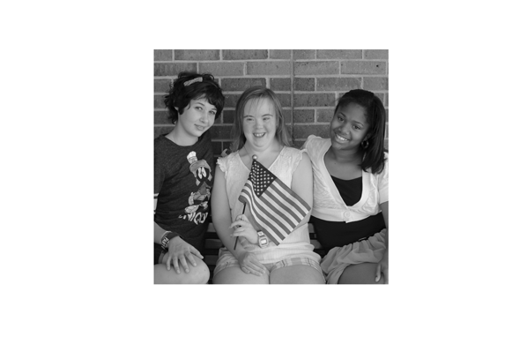
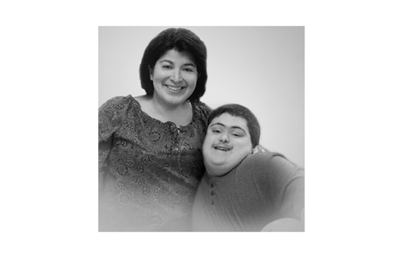
E X C E P T I O N A L F A M I L Y M E M B E R P R O G R A M
Fort Hood ACS Workshop
“SPLITTING HAIRS,
Understanding Comorbidity”
The term comorbidity refers to a person having more than one diagnosis or condition that exist alongside another diagnosis. An understanding of how the two conditions function together is crucial to planning and treatment.
Workshop Speakers:
Ms. Bailey Marshall, Counselor at STARRY
Ms. Jaimi Maldonado at STARRY
When: April 1, 2016, 9:30-11:30am
Where: Lane Volunteer Center
This workshop is open to ALL
(Soldiers, Family Members and Professionals.)
Building 16005 (corner of TJ Mills and Old Ironside)
To register call (254) 287-6070 or
email: usarmy.hood.imcom-fmwrc.list.ACS-EFMP@mail.mil
Follow us on Facebook @ Fort Hood EFMP.
Individuals who require assistance or accommodation due to disability, please contact the ACS EFMP office at (254) 287-6070 by the Monday before the workshop meets .
71000.12

